Slide 1
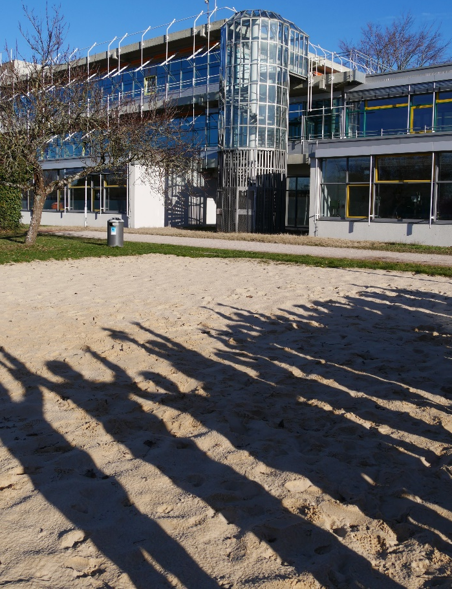
Welcome
to our school!
class 5c + Miss Rother
(English Project: 2019)

Slide 2
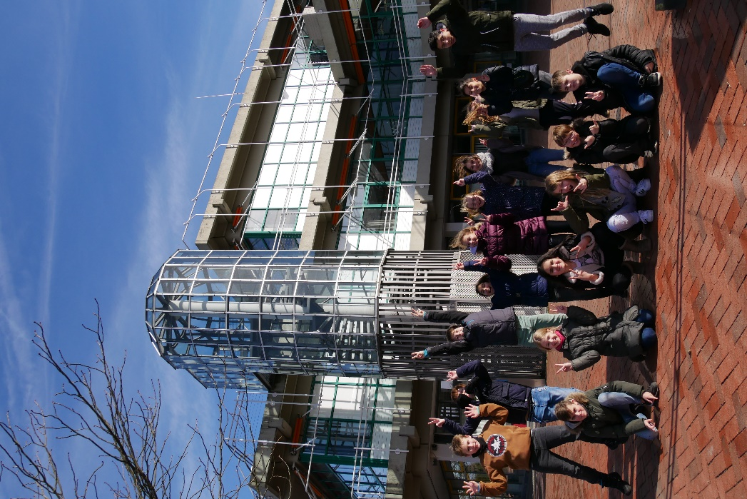
Here you can see our modern school building!
Anne- Frank- Realschool

Slide 3
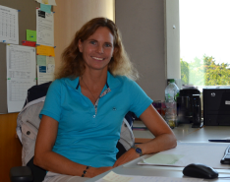
This is our principal
Miss Rödiger
(update: 2023)

Slide 4
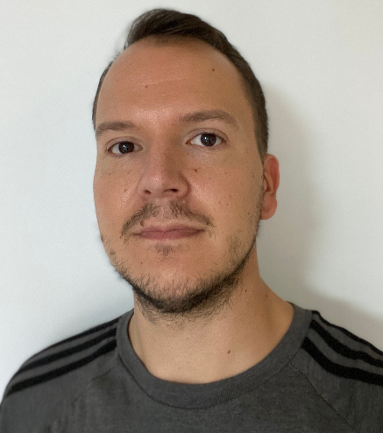
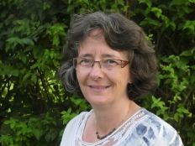
Our new vice principal team (update: 2023)
Miss Heinen
Mister Schiebenes

Slide 5
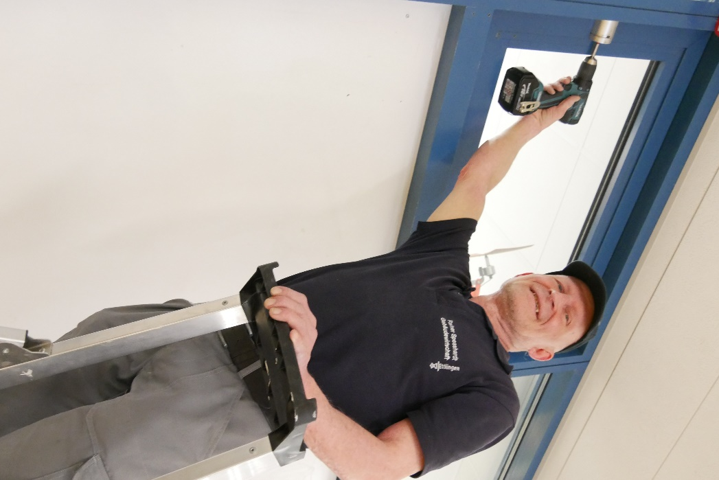
Our caretaker
(Mister Spesshardt)
I can repair
everything!

Slide 6
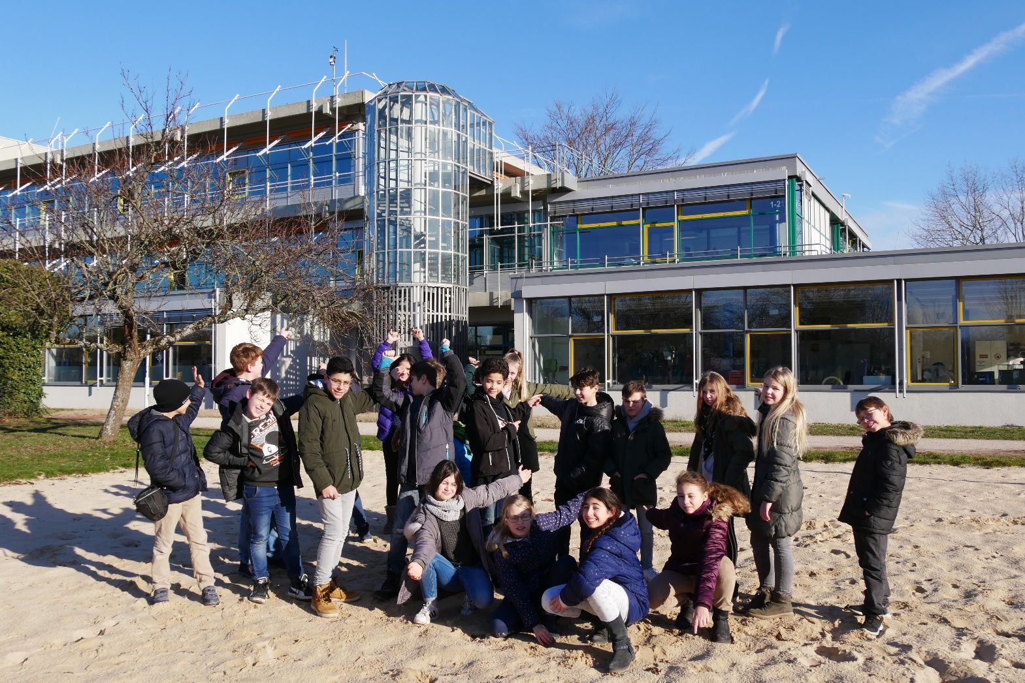
We love our school!
There is even a beach volleyball field!

Slide 7
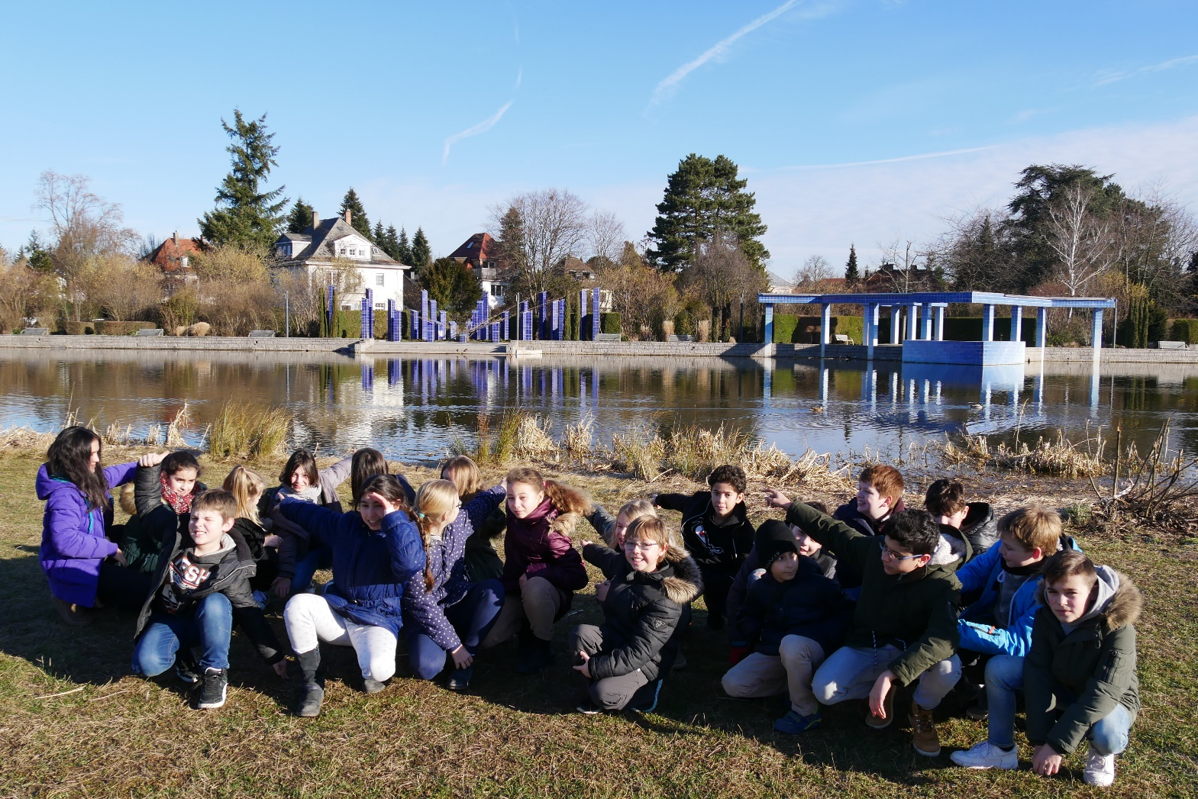
We have got our own big park and lake!

Slide 8
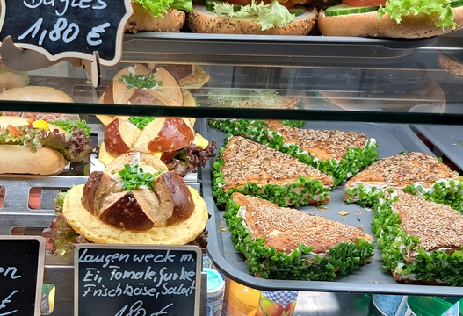
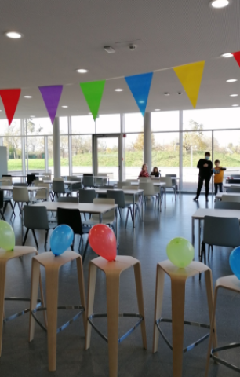
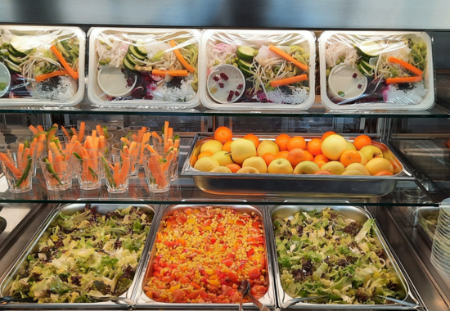
Our cafeteria: yummy!
(update 2023)

Slide 9
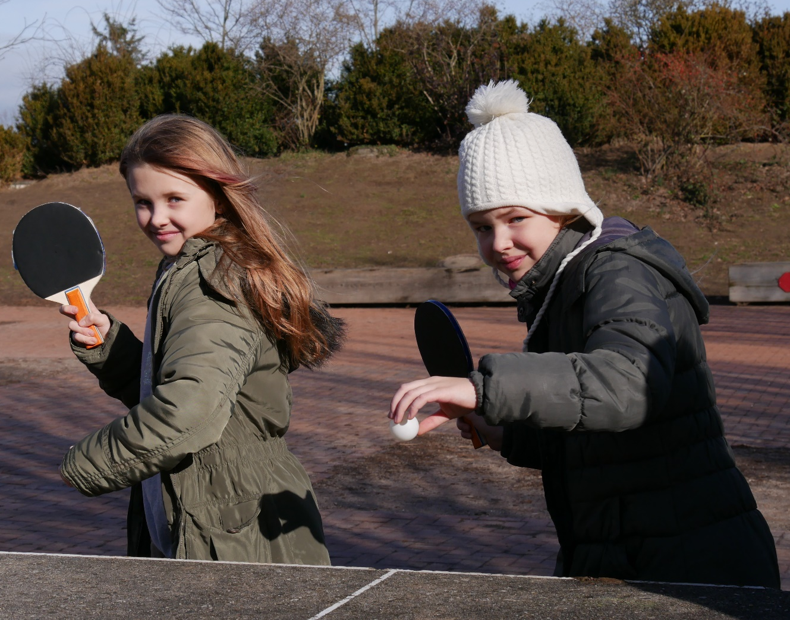
In our school you can do a lot of sports:
Come on….
Let`s play table-tennis!

Slide 10
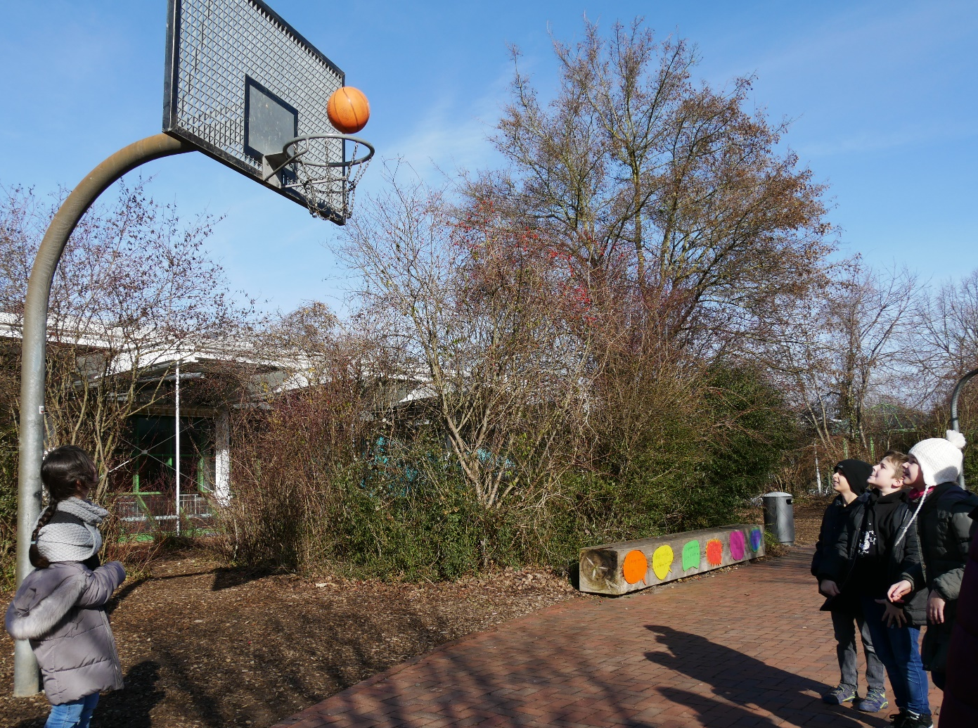
Let`s play basketball!
Throooow!

Slide 11
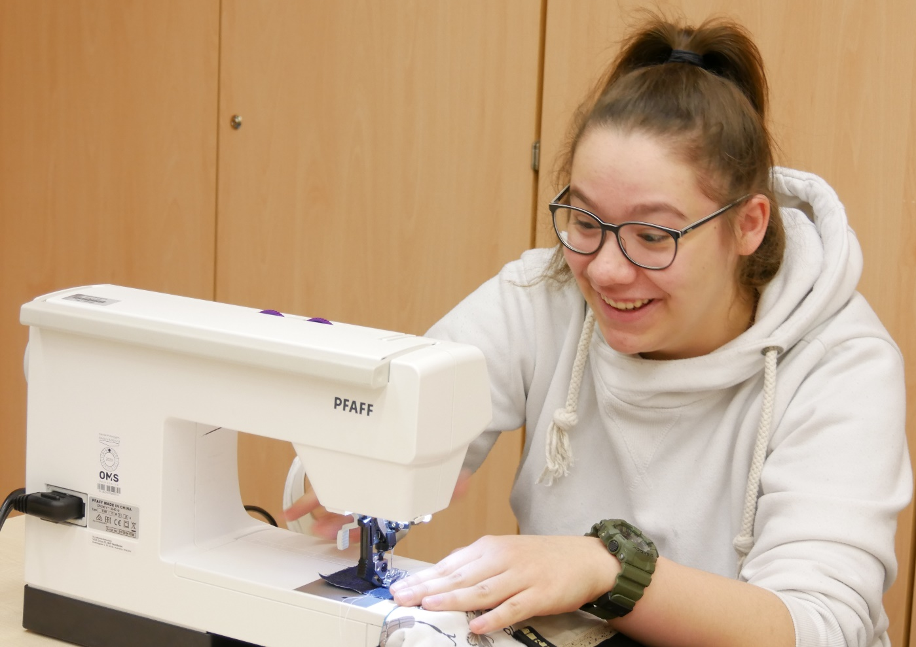
There are many clubs:
Sewing club with Julia

Slide 12
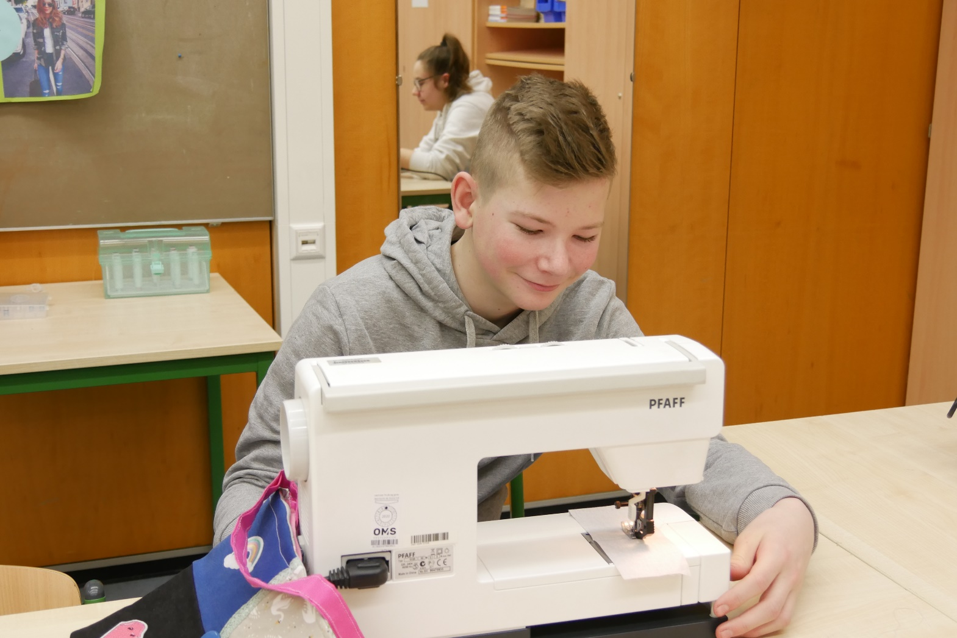
Sewing club – boys are fashion designers, too!
(Felix)
I want to be
a fashion designer
for Nike!

Slide 13
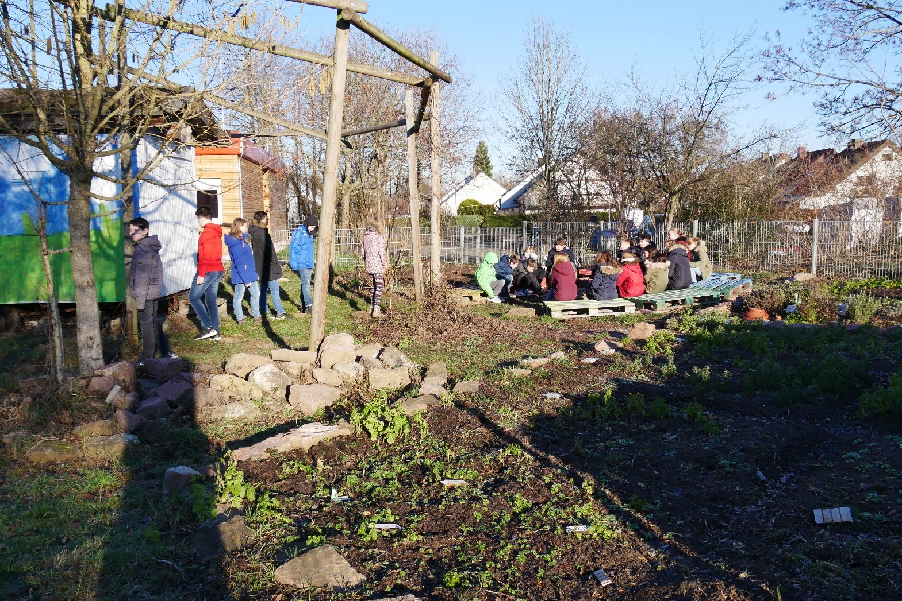
Our garden club:
Hard work, but fun!

Slide 14
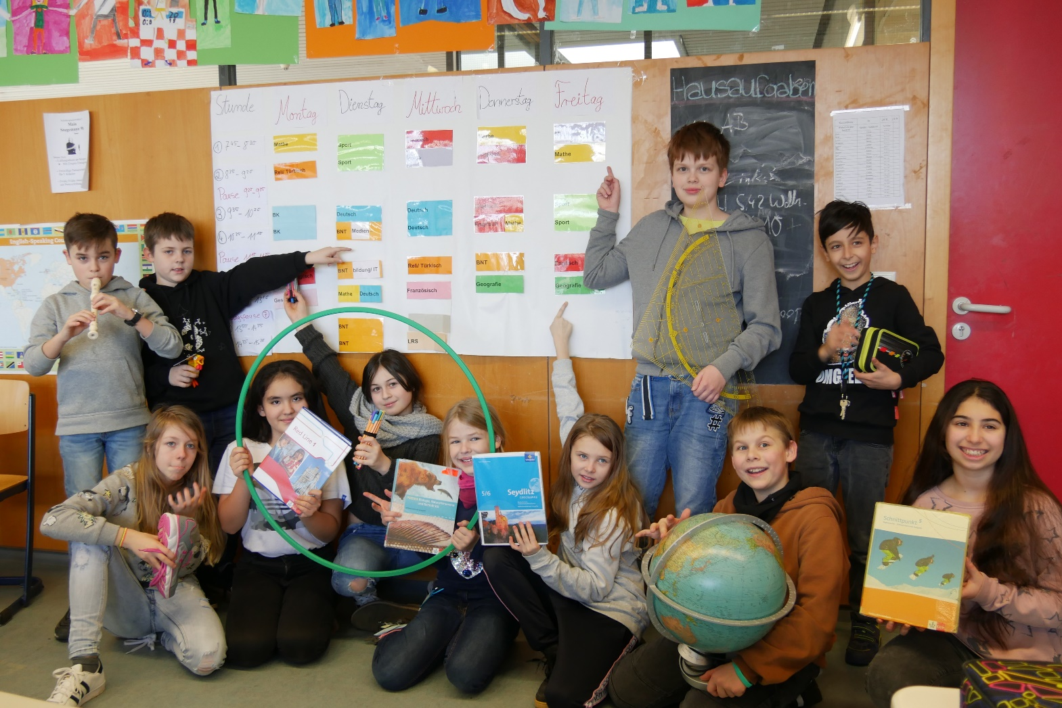
Look at our timetable:
There are so many interesting subjects in our school!

Slide 15
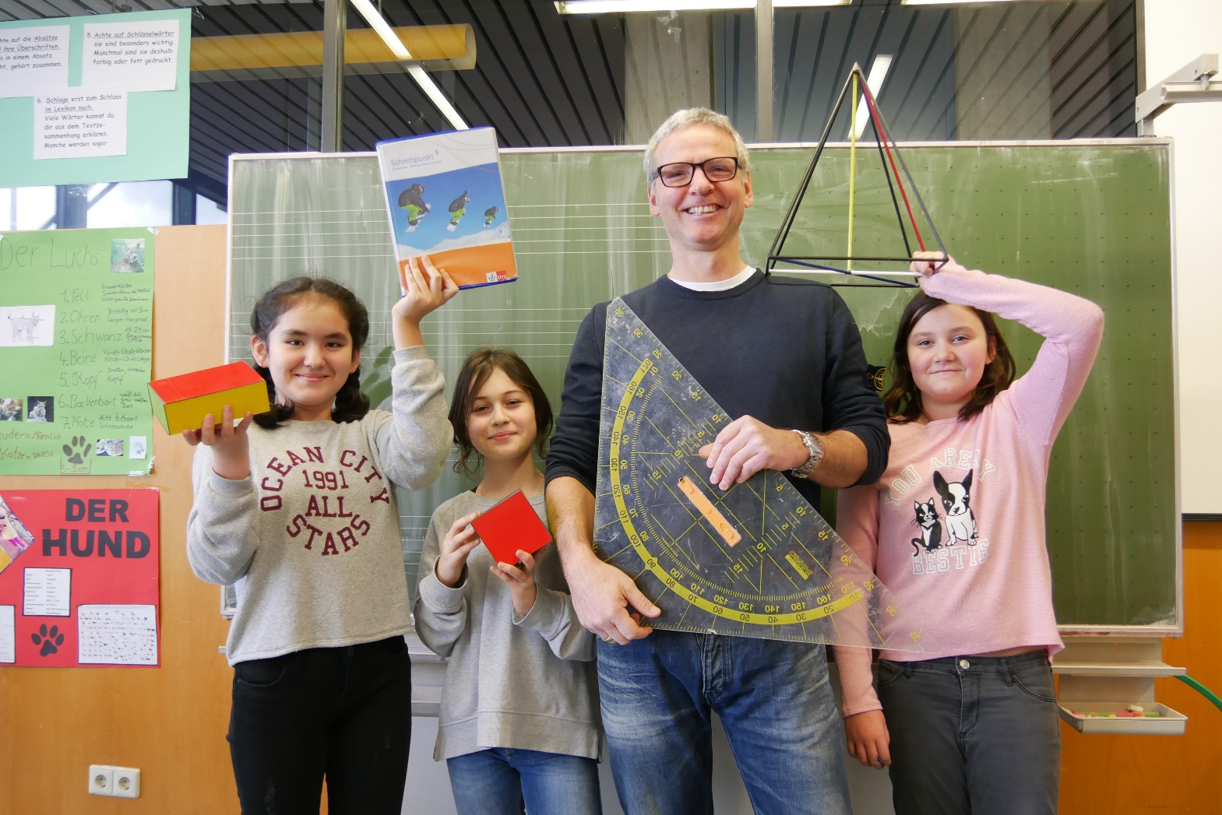
Our funny teachers: in Maths Mister Volz

Slide 16
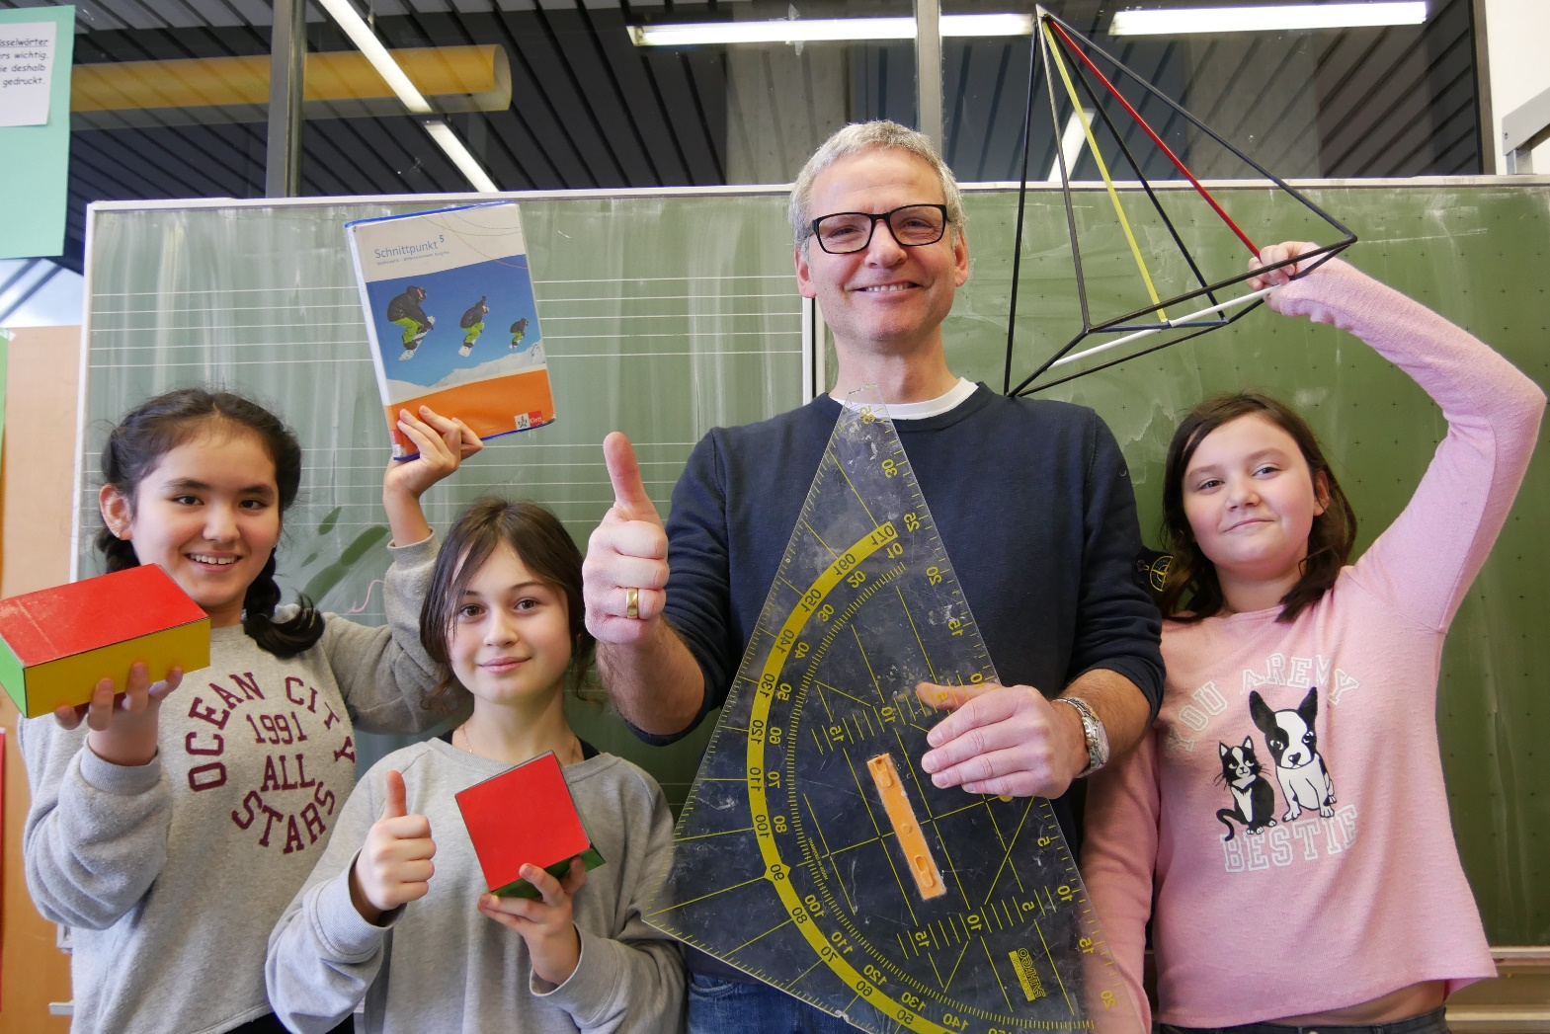
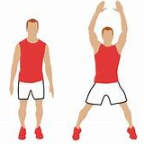
Mister Volz teaches Maths and Sports.
He is clever in Maths, but a famous football trainer, too!
I can do gymnastics, too!

Slide 17
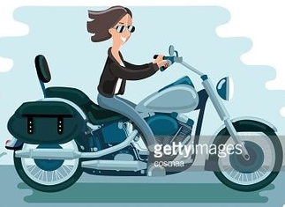
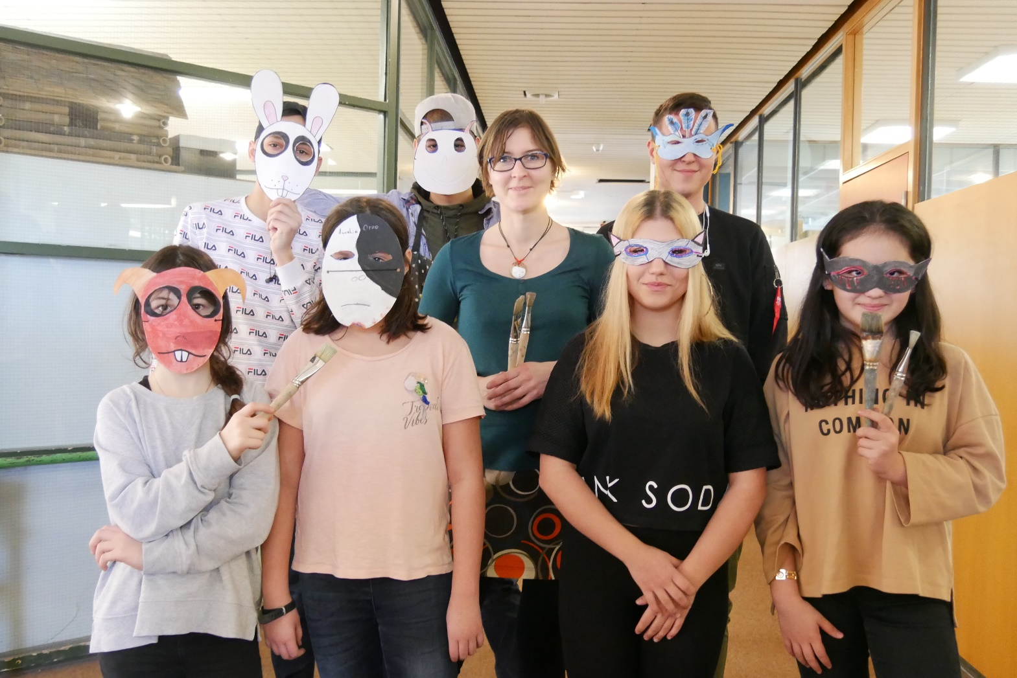
German+Art
(Miss Boebel)
There are many great projects!
Come to us and become an awesome artist!
And I have a motorcycle, too

Slide 18
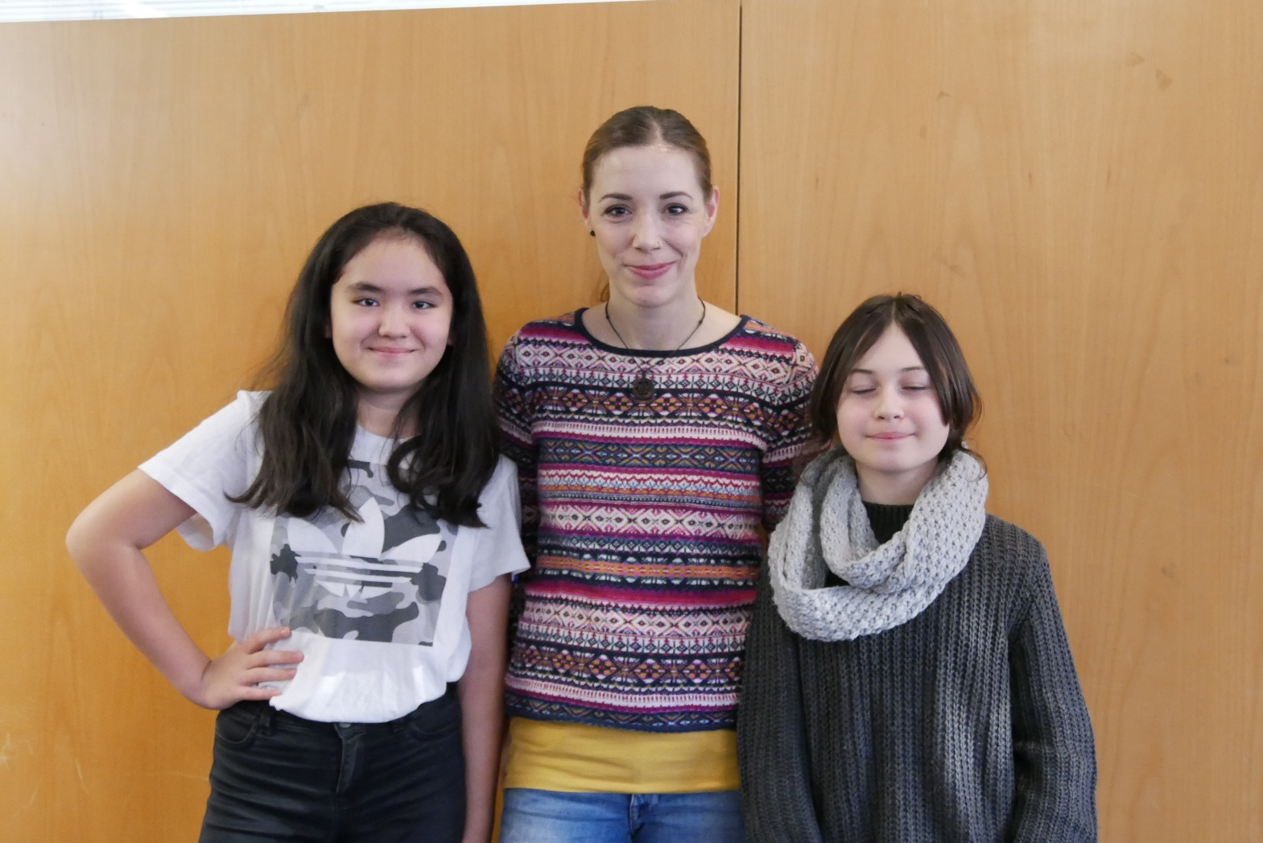

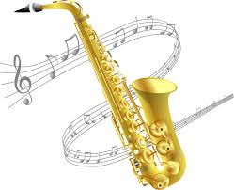
Music +
Dance
(Miss Cierna)
You can learn to dance Hip Hop!
Yeah!
Hip Hop

Slide 19
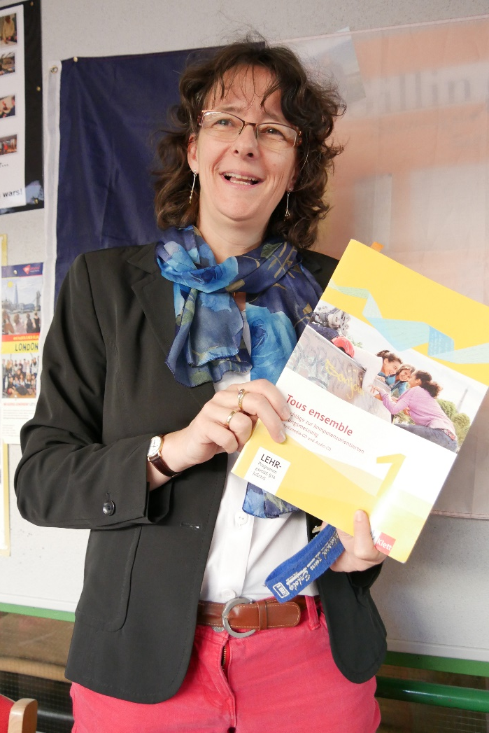
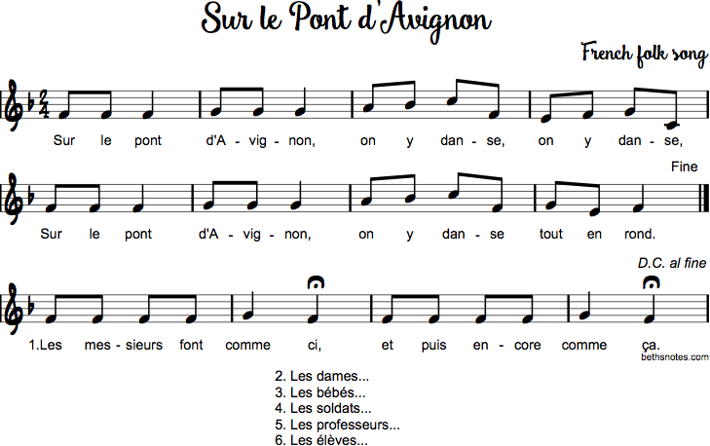
French and
Music
(Miss Heinen)
Bonjour!
Sur le pont,
d‘Avignon….

Slide 20
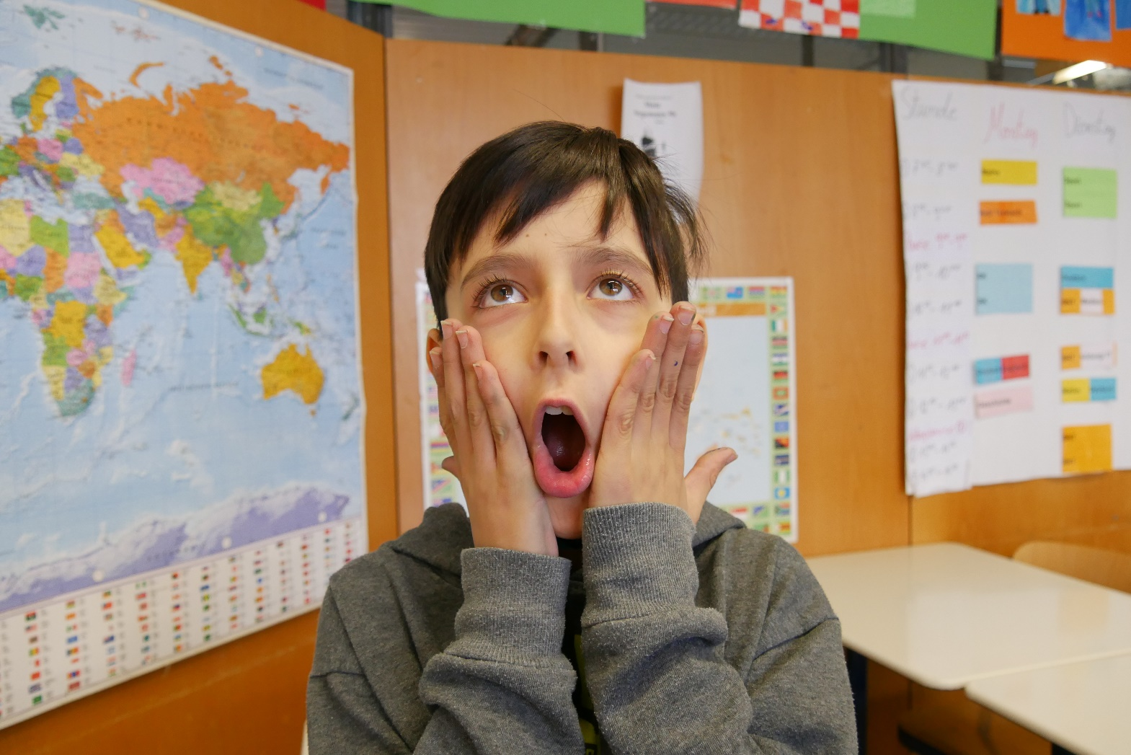
„And we get soooooo much homework!“ (Marius)
Oh, no!!!

Slide 21
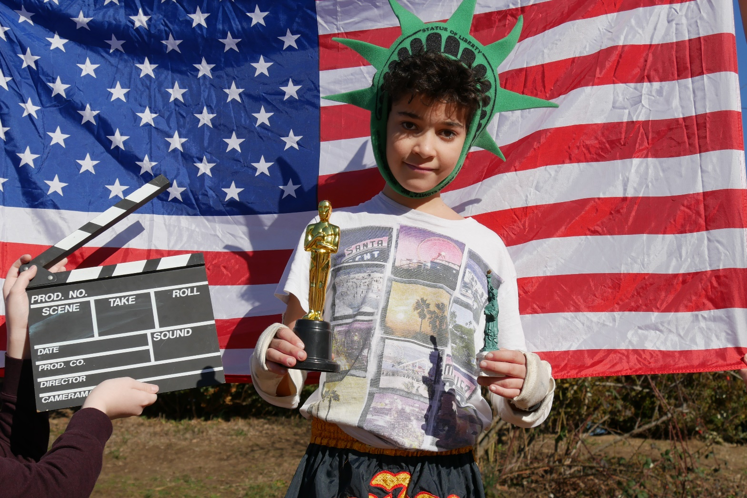
English with Miss Rother!
---------
Learn English!
They speak English... in the USA!

Slide 22
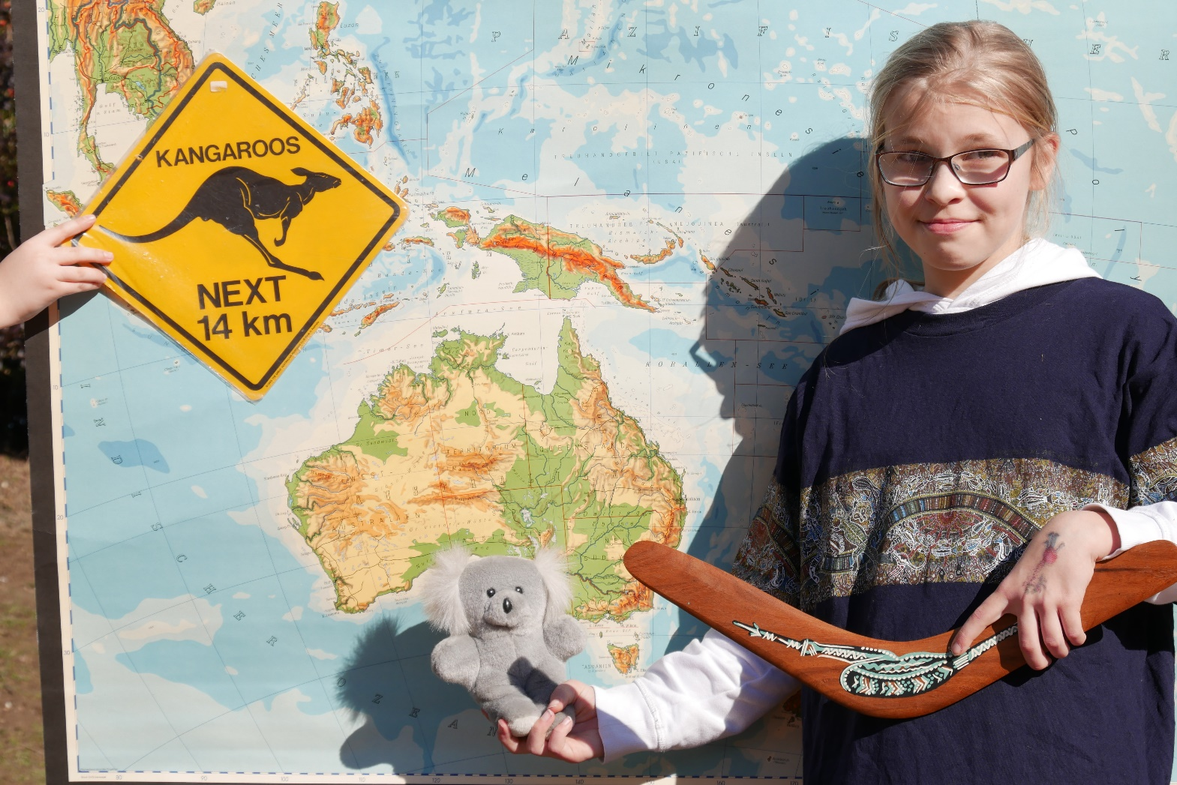
… and in Australia!
G‘day
from Australia!

Slide 23
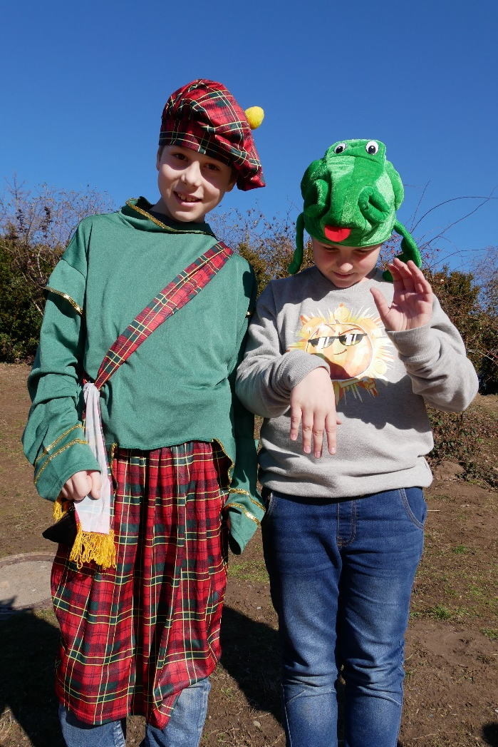

They speak English…. in Scotland !
I am Nessi!

Slide 24
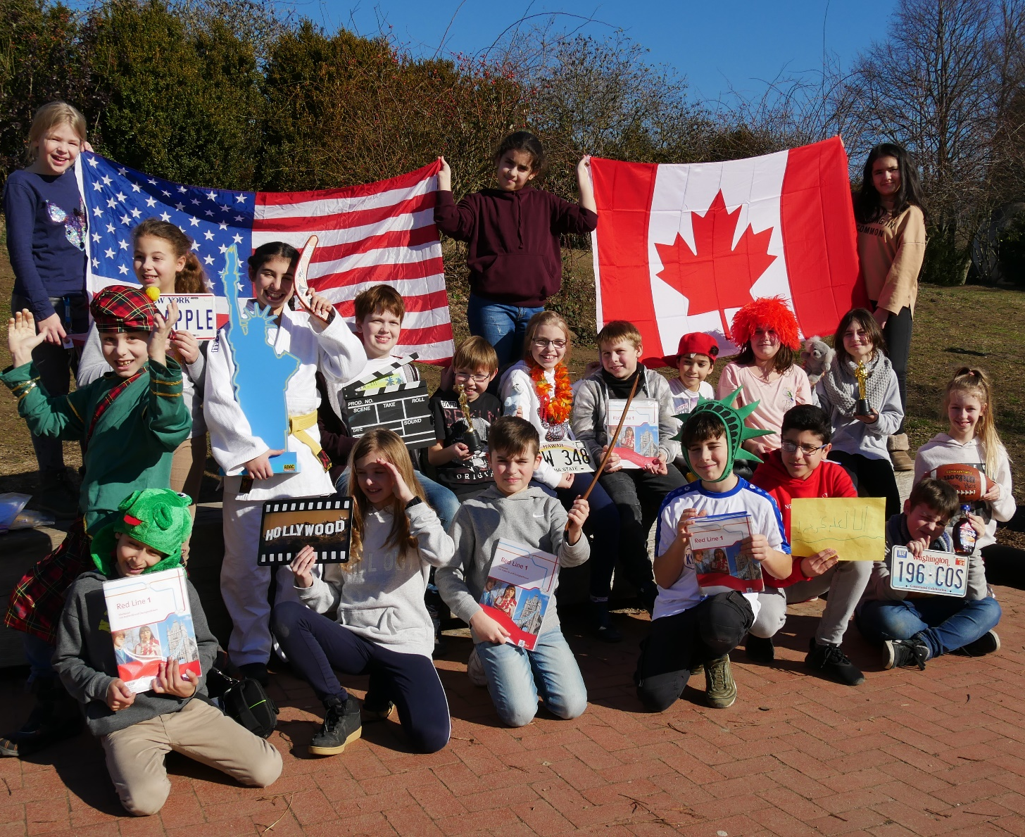
„But….. we speak English in Ettlingen, too!“

Slide 25
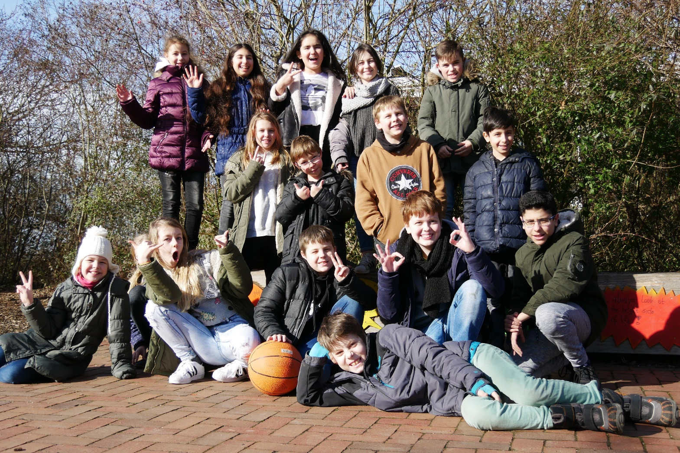
We are the amazing class 5c

Slide 26
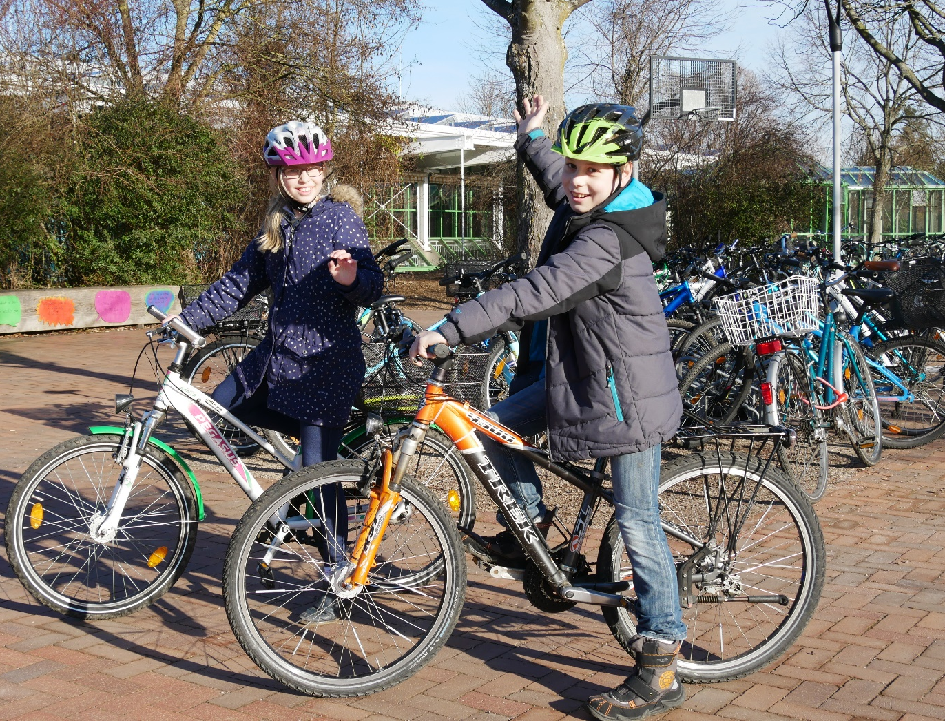
Class 5c:
„Of course…
We come to school by bike!“

Slide 27
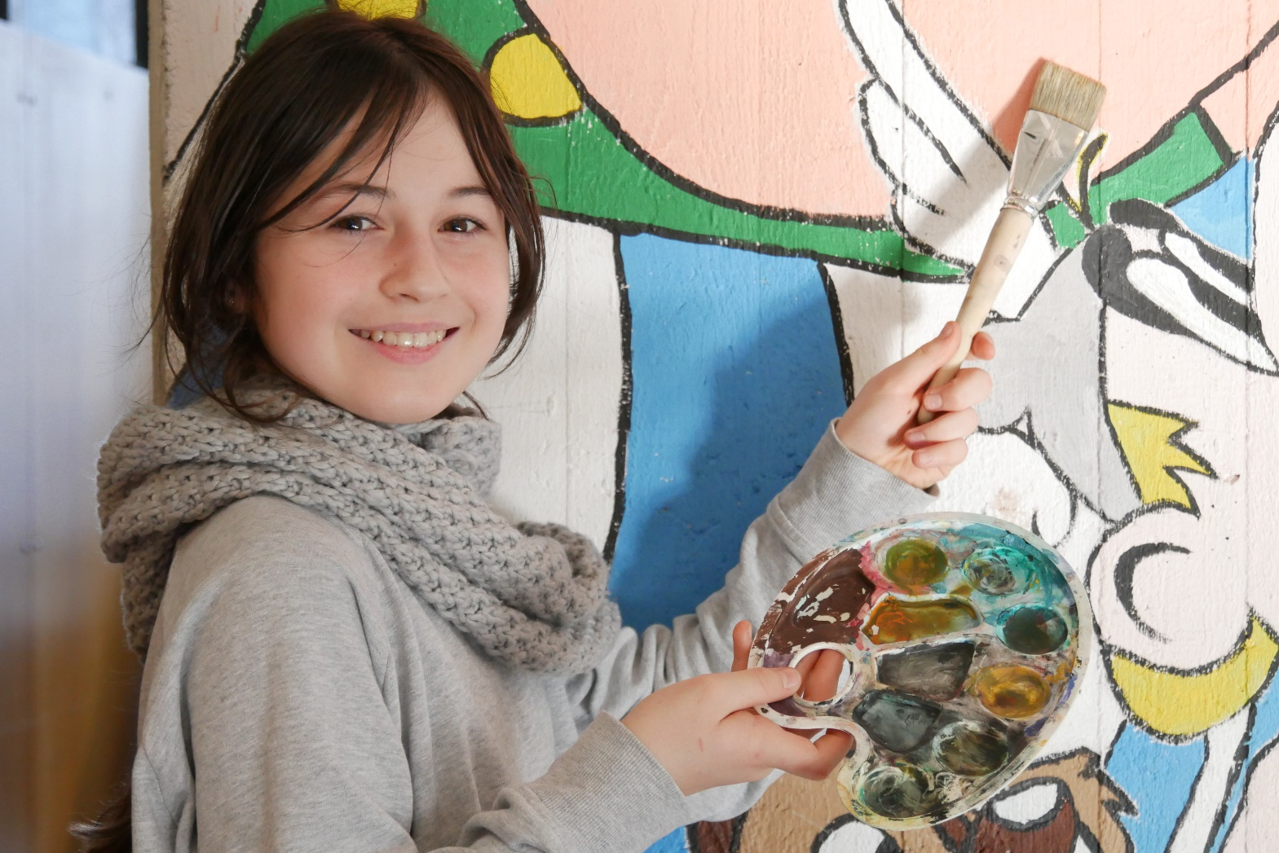
Our students have many talents:
Julia is
–an artist

Slide 28
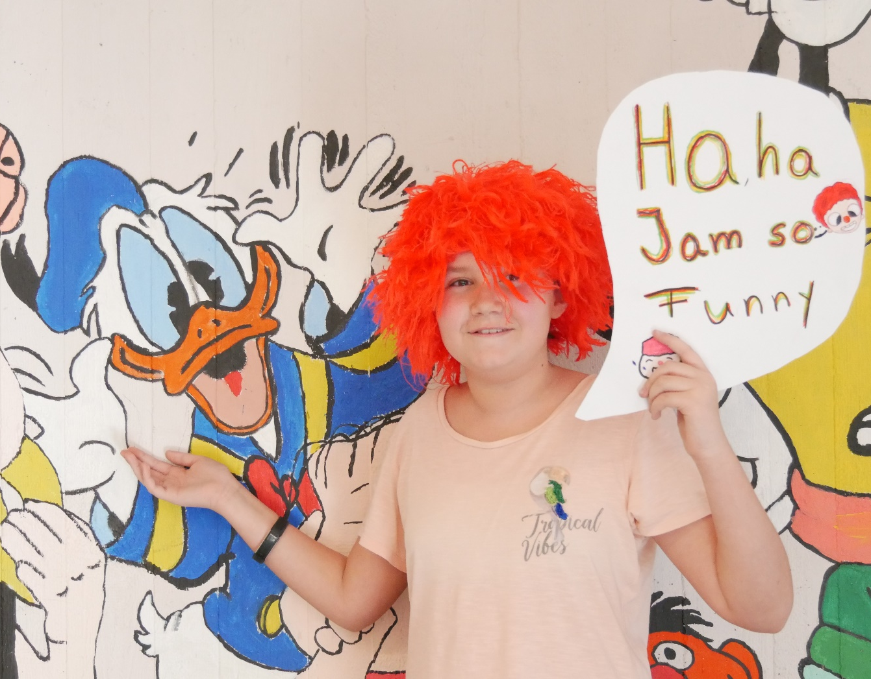
Aurelia can make you laugh– what a funny girl!

Slide 29
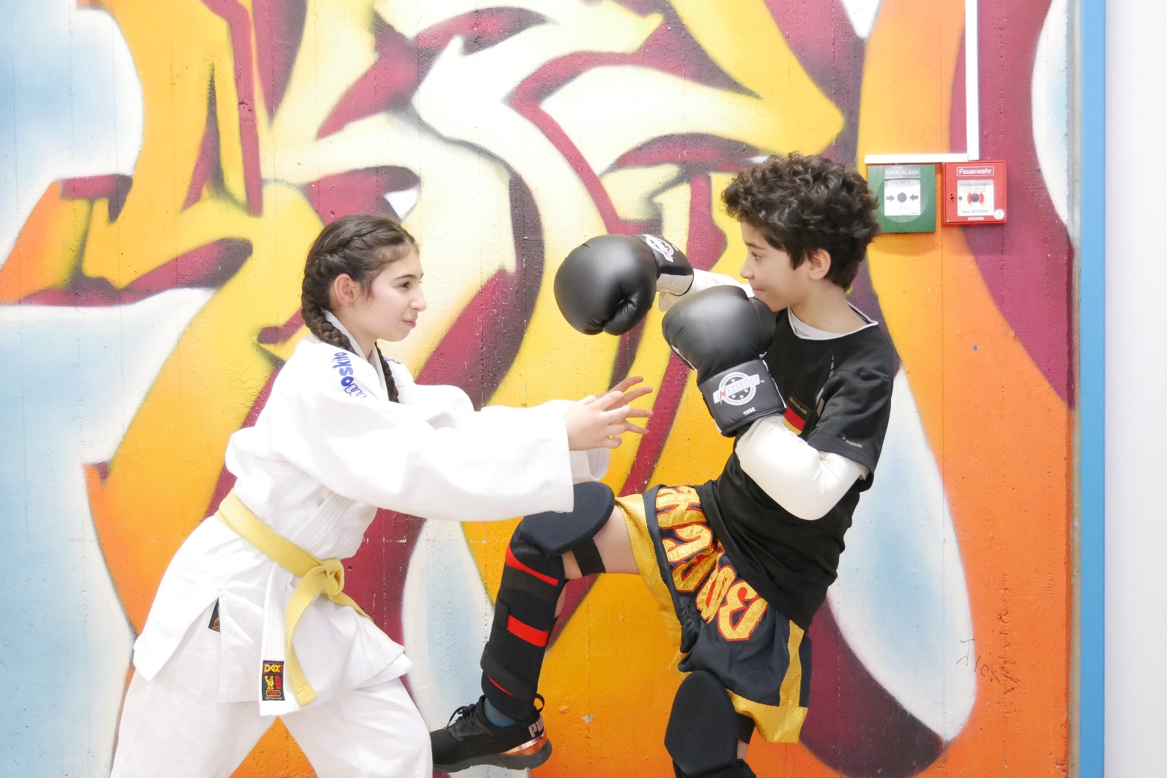
Watch out!
Some students are good at Judo and Kickboxing
(Celina and Christopher)

Slide 30
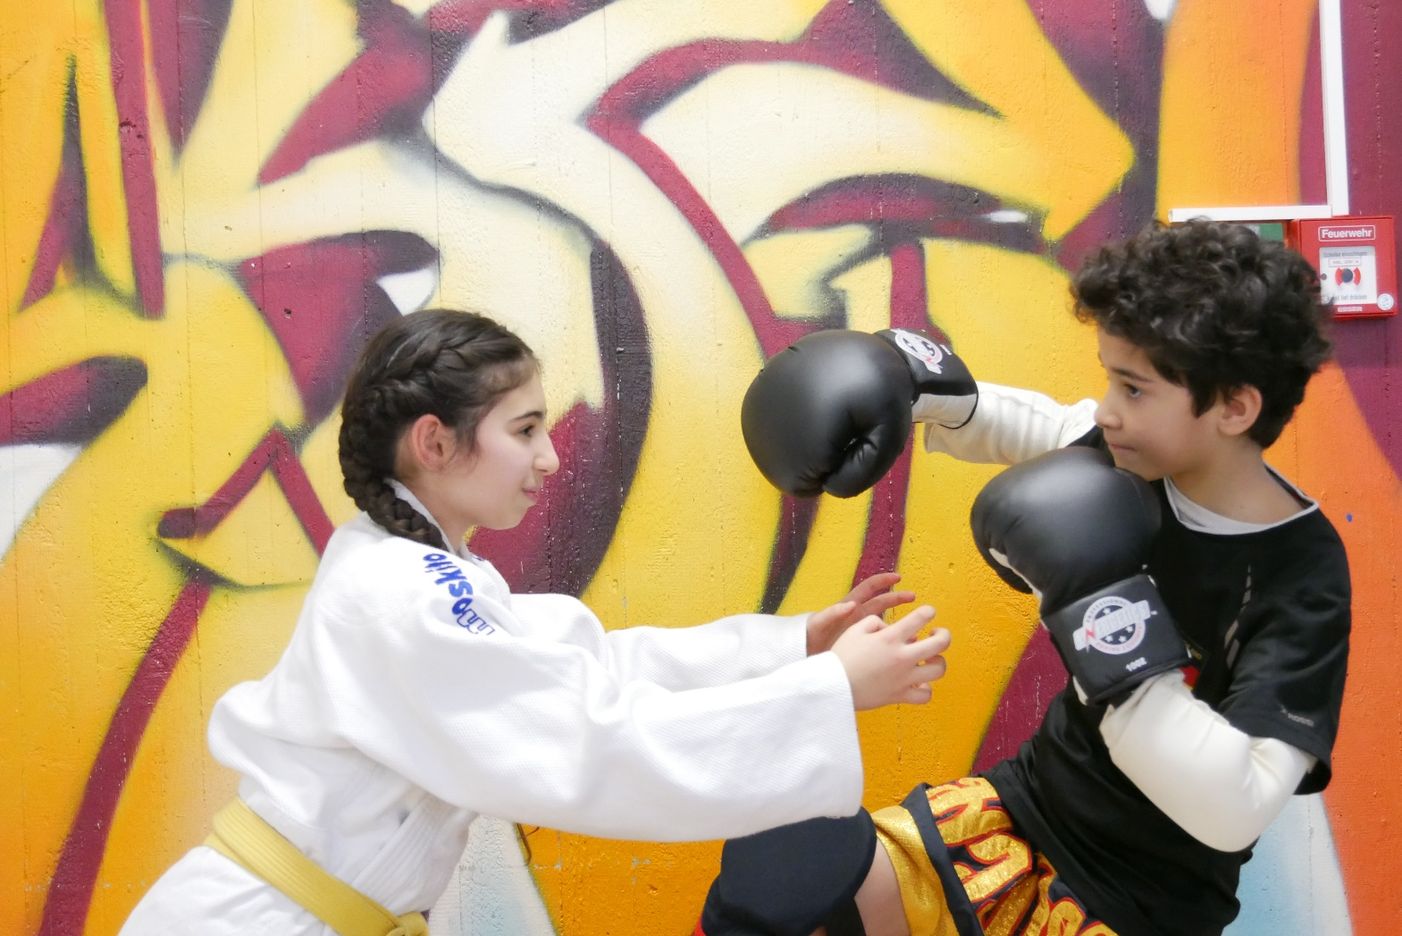
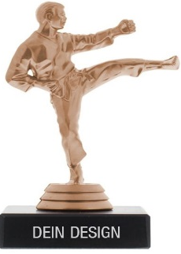
Judo and Kickboxing
Watch me!
I am sooooo good!

Slide 31
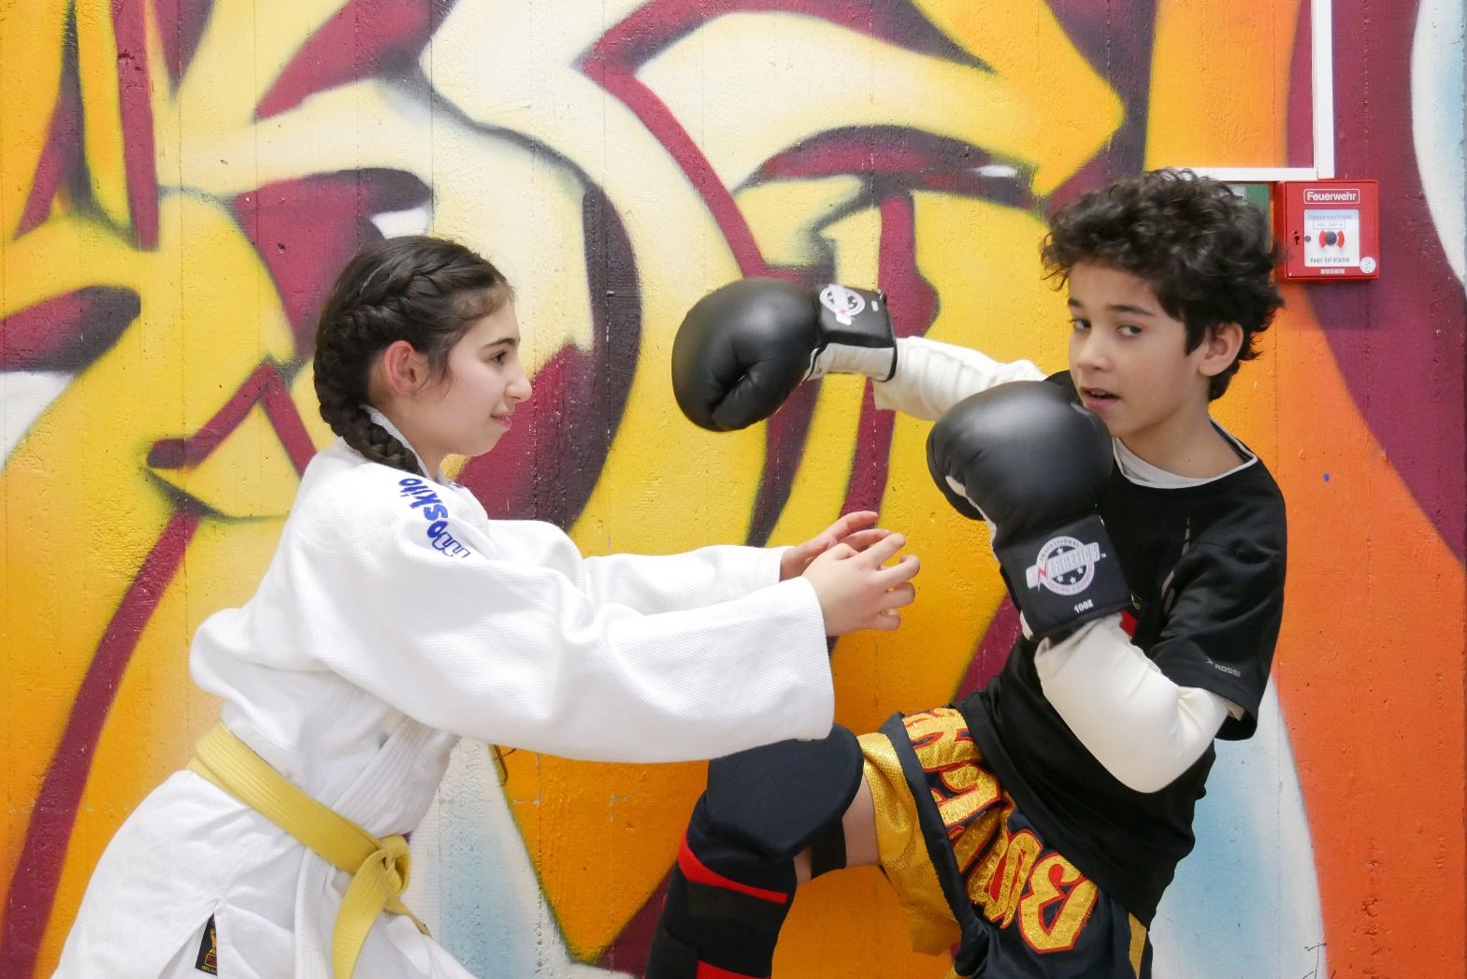
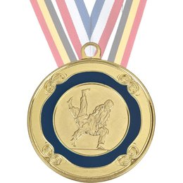
But I am the best!

Slide 32
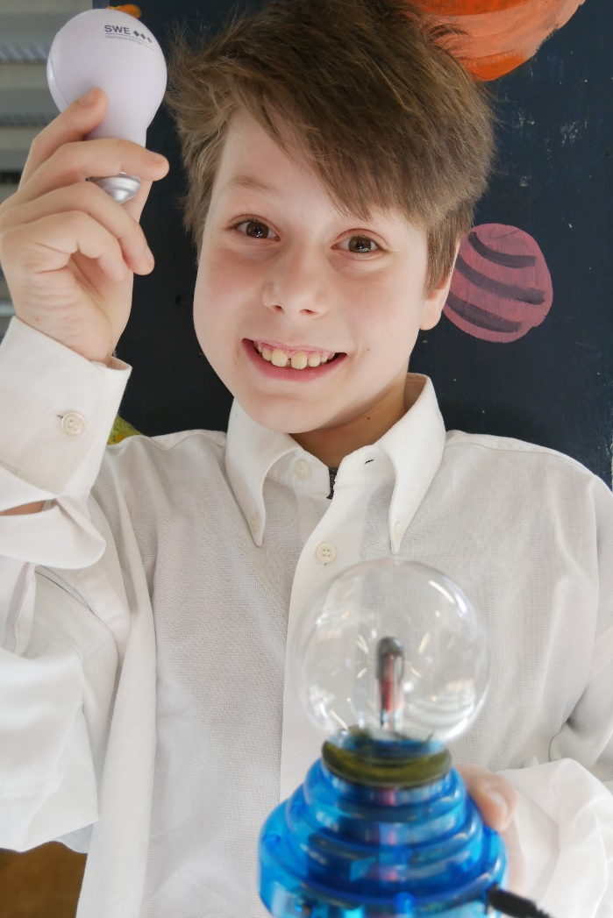
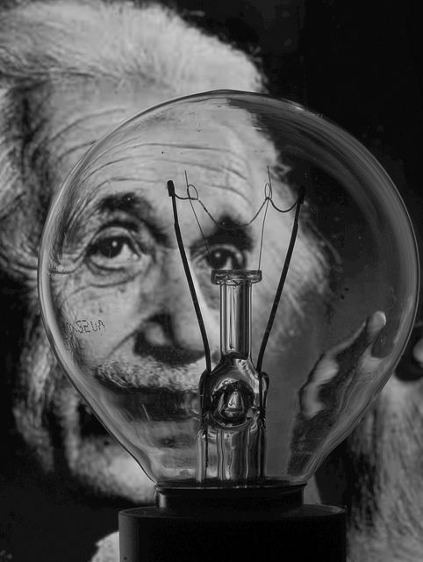
Our plans for the future:
„One day we want to be as intelligent as Albert Einstein!“
Simon

Slide 33
Goodbye from
our class 5c
and their
English teacher
Miss Rother
and….
welcome to our school!
(2019)

